Slide 1
Loops and Lists
IMM 120 - Nov 5

Slide 2
Congrats on your Midterms!
If you haven’t received a grade, I hope you received a message from me.
Notes:
Walk around a village, a few spooky mazes, some impressive physics.

Slide 3
Loops
Loops repeat code over and over while a condition is true.
“Computers are fast, not smart”
Patterns
Hundreds of objects
Cleaner code
Less intensive setup
Data Visualization

Slide 4
While Loops
Work the same as if statements except they repeat their code block (what’s inside their brackets) while their conditional is true.
aka. until it is false
If there is a cup on the table, take one.
While there is a cup on the table, take one.

Slide 5
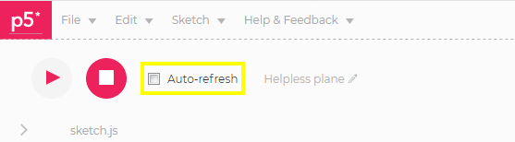

Slide 6
Counting Loops
var count = 1 ;
while(count <= 200 ) {
// count goes through every value
// 1, 2, … , 198, 199, 200
count ++;
}
// count == 201
Notes:
So you could sum all the numbers

Slide 7
While Loops
var x = 10 ;
while(x < 200) {
line(x, 100, x, 300);
x += 10 ;
}
Notes:
Play around with these numbers, see what kind of an effect this has

Slide 8
While Loops
var x = 10 ;
while(x < 200 ) {
line(x, 100, x, 300);
x += 20 ;
}
Notes:
Play around with these numbers, see what kind of an effect this has. Try to give them a label.
Start, end, change

Slide 9
While Loop Essentials
Start
Condition
Change
Make sure your start + your change will eventually be false inside your condition.
var x = 10;
while(x < 200) {
line(x, 100, x, 300);
x += 20 ;
}

Slide 10
While Loop Essentials
Start
End Condition
Change
Make sure your start + your change will eventually be false inside your condition.
var count = 10;
while(count >= 1) {
count -= 2;
}

Slide 11
While Loop Essentials
Start
Condition
Change
Make sure your start + your change will eventually be false inside your condition.
var y = 2;
while(y < height) {
y *= 2;
}

Slide 12
While Loop Essentials
Start
Condition
Change
Make sure your start + your change will eventually be false inside your condition.
var xPos = mouseX;
// mouseX == 300
while(xPos < 200) {
xPos += 10;
}

Slide 13
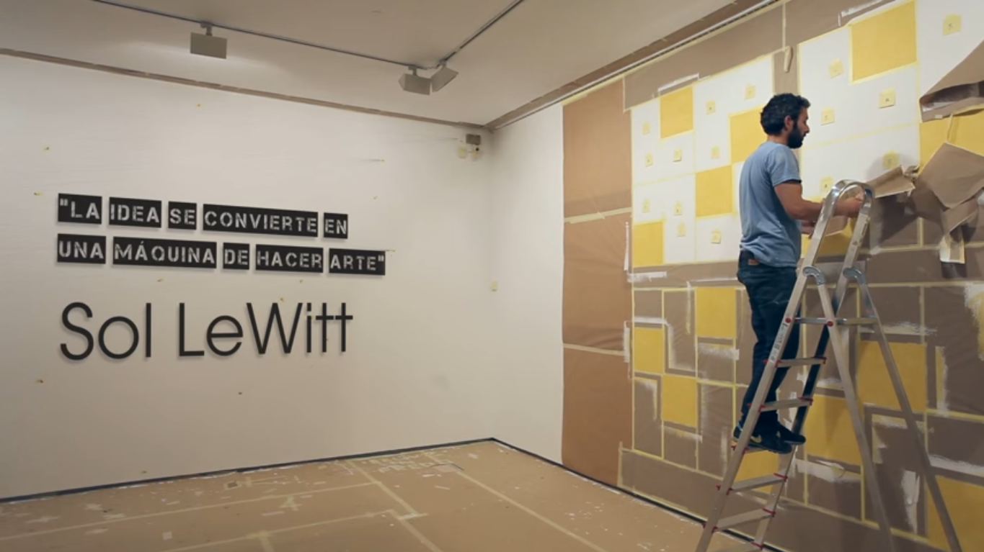

Slide 14
Wall Drawing #17 (1969) Four-part drawing with a different line direction in each part.

Slide 15

Notes:
Focus on the first two and maybe one diagonal

Slide 16
Arrays (lists)
312
313
314
315
316
317
318
319
320
321

Slide 17
Arrays
var numbers = [7, 8, 20];
0
1
2
7
8
20

Slide 18
Arrays
var numbers = [7, 8, 20];
ellipse(x, y, numbers[2]);
0
1
2
7
8
20

Slide 19
Arrays
var numbers = [7, 8, 20];
numbers[2] = 99;
0
1
2
7
8
99
20

Slide 20
Arrays
var numbers = [7, 8, 20];
numbers.length == 3
var index = 0;
while (index < numbers.length) {
index += 1;
}
0
1
2
7
8
99

Slide 21
Arrays
var numbers = [7, 8, 20];
numbers.length == 3
var index = 0;
while (index < numbers.length) {
index += 1;
}
0
1
2
7
8
99

Slide 22
Let’s Try It
https://editor.p5js.org/crhallberg/sketches
“Drawing Board (before loops)”
Notes:
Do the drawing part, have them do the rectangle part.

Slide 23
Arrays + Objects
circles[0] = {
x: 100,
y: ###,
d: ###,
fill: color
}
YOUR TURN: Draw 5 circles on the screen
Notes:
Click to add a circle

Slide 24
Adding to an Array
arr[arr.length] = 7; // adds one to the array
arr.push(7); // same
YOUR TURN: make a sketch that saves a circle every time you click

Slide 25
Making Arrays Dynamically
var arr = [];
function setup() {
var count = 0;
while (count < 100) {
arr[count] = random();
count++;
}
}
YOUR TURN: Draw 50 circles on the screen

Slide 26
Professor Jesse Schell is speaking
video game designer, author, CEO of Schell Games, and Distinguished Professor of the Practice of Entertainment Technology at Carnegie Mellon University
Professor Schell will speak at the Mayo Concert Hall about new frontiers in Augmented Reality and Virtual Reality until 9pm

Slide 27
Minute Surveys
Today was a doozy, all questions and feedback on your sheets please!

Slide 28
UNRELATED POP QUIZ!

Slide 29
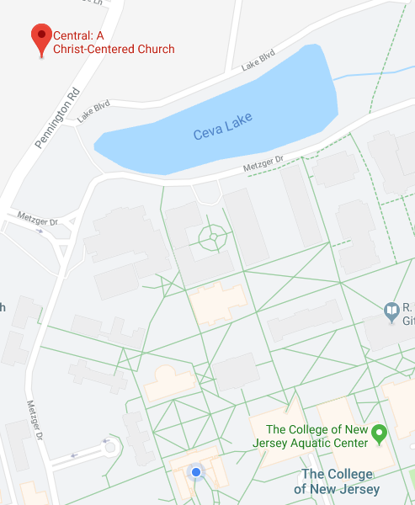
UNRELATED POP QUIZ!
What is happening tomorrow?
ELECTION DAY!
Where is your polling place?
CHURCH ACROSS THE STREET!
When can you vote?
ANY TIME BETWEEN 6am and 8pm!
Do you have to go alone?
NO! Groups from the Student Center on the hour!
(from 10am until 7pm)
https://vote.tcnj.edu/voting-day
Notes:
If you were registered on campus.
Are there any rewards for voting! No! It’s illegal. ☹

